Slide 1

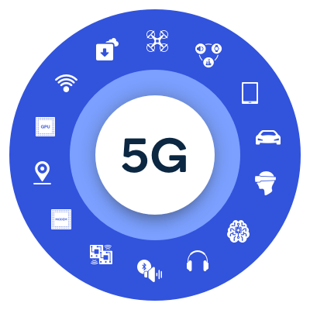

Mobile Computing
WS 2023-24
5G CloudConnect with UERANSIM Integration
Guided by : Armin Lehmann
Masters in Engineering
Information Technology
Team Gen5 Designers - Project members
Nastayeen Abdul Majid 1427970
Shiva Kumar Biru 1436929
Jenny Nadar 1427226
Sriram Karunanithi 1438891
Start date : 4 Dec 2023
End date : 25 Feb 2024
1

Slide 2
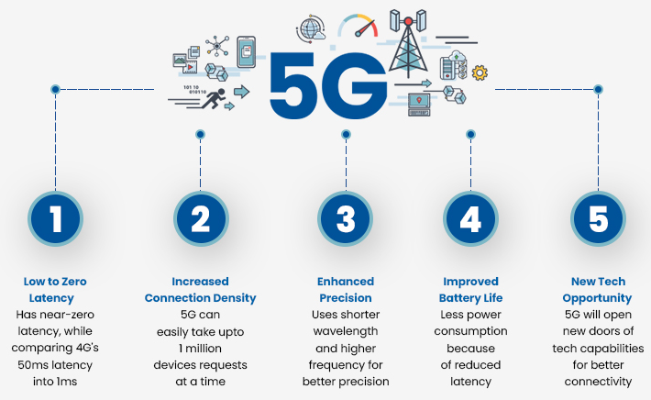
Contents
Introduction to our project
Project architecture
Requirements
Planning
Realization of the project
Execution
Network slicing
Conclusion
References
2

Slide 3

1. Introduction to our project
Objective
5G core, including
Radio Access Networks (RANs)
User Equipment (UEs)
Data Networks (DNs)
Network Slicing
One or multiple services with specific functionality to different tenants
Ensure the separation of the services and end-users (Network slicing)
Set of RANs and DNs connected via slices
Implement 5G core with Service-based Architecture (SBA) several network functions.
3

Slide 4

..Introduction to our project
Scope of the Project
Fundamental 5G design principle is a Service Based Architecture (SBA)
comprehensive modularization for compiling & combining network functions flexibly.
Design principle of network softwarization, like
application of NFV (Network Functions Virtualisation), SDN (Software-defined Networking) for the realization of Network Function instances and their interaction, & multi-tenant capability (network slicing)
Enabling several tenants, like
a mobile network operator, a fixed network operator & MVNO (Mobile Virtual Network Operator) for eMBB, a Smart Grid Provider & service provider for autonomous vehicles for URLLC,
& for operating several logical communication networks with different characteristics parallelly on one physical network platform
4

Slide 5
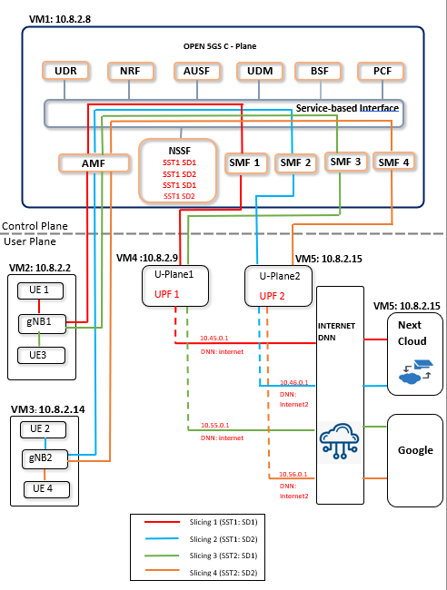
2. Project architecture
Components
5 Virtual Machines(VMs)
User Plane
4 User Equipments(UEs)
2 gNodeB(gNBs)
Control Plane
2 User Plane Function(UPFs)
4 Session management function(SMFs)
NSSF
SST1 SD1, SST 1 SD2
SST2 SD1, SST2 SD2
Data Network
NextCloud
5

Slide 6
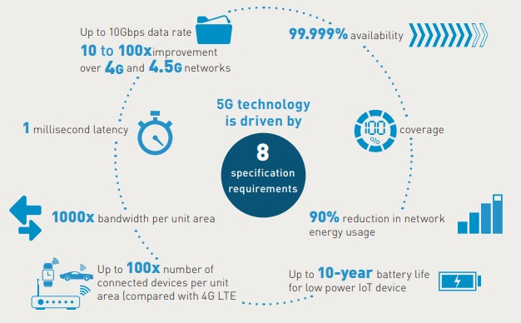
3. Requirements
Installation of virtual box
Creation of Virtual machines for both 5Gcore and UERANSIM
Install Operating Systems
Go to Network settings in virtual box to enable Adapters 1 and 2
Changes for creating a static IP for each VM
Installation of Wireshark
Installing MongoDB and Open5GS
Getting MongoDB
Installation of Open5GS in our Ubuntu on VM
Installation of WebUI of Open5GS
Installation of UERANSIM
Installation of Next Cloud
6

Slide 7
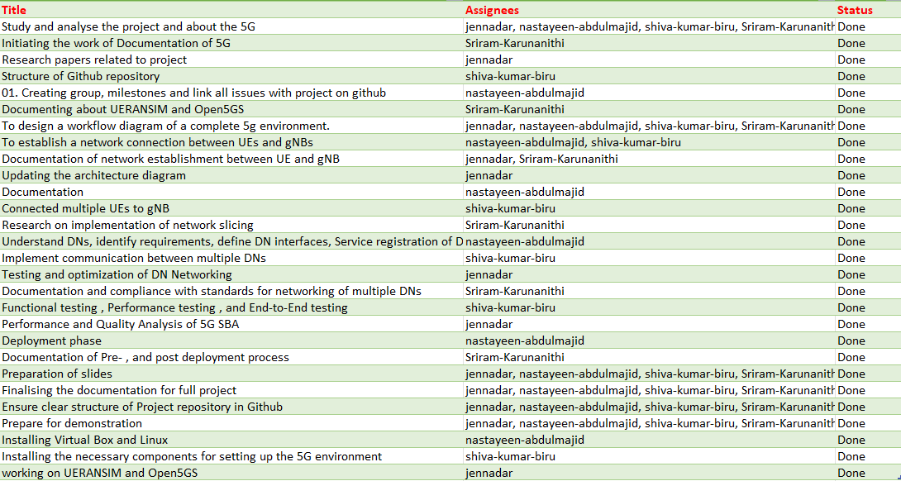
4. Planning
7

Slide 8
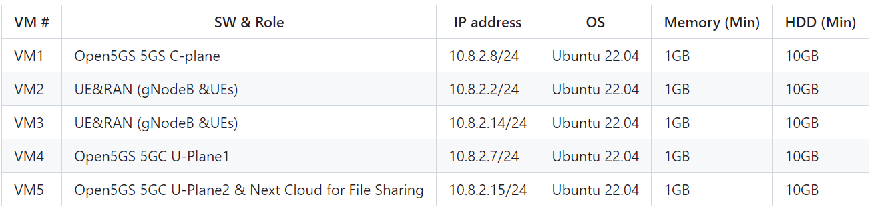
5. Realization of the project
Each VM are as follows:
Two UEs were created in two separate VMs.
Separate slicing to each User Equipment for File Sharing.
UE1 uses the slice marked with colour Red
UE2 uses slice marked with colour Blue
8

Slide 9
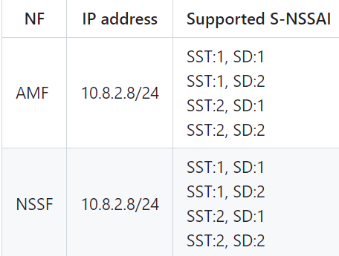
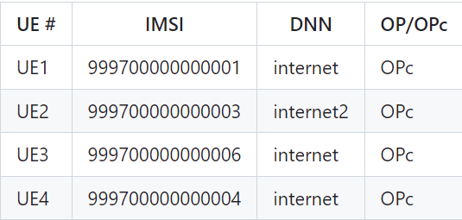
Subscriber Information (other information is the same) is as follows. These User informations were registered with Open5GS WebUI
UE1 and UE2 have access to File sharing with UPF1 and UPF2 respectively. The NSSF file is used for network slice selection as per the slicing parameters provided by the UEs.
9

Slide 10
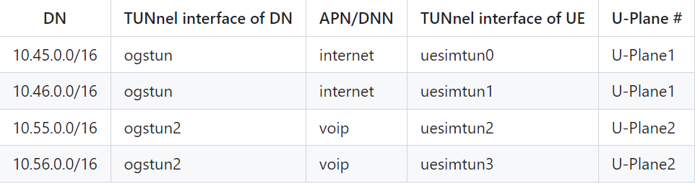
Each DN are as follows.
10

Slide 11

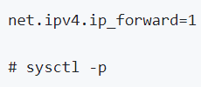
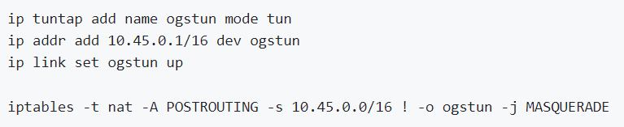
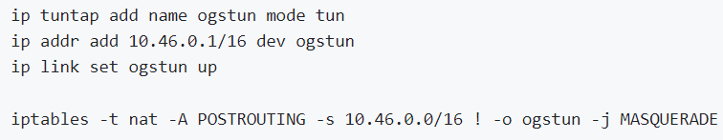
Execution
A) Prerequisites
Network Settings of Open5GS 5GC C-Plane
Before starting the SMF's files, configure the network setting of SMF1&2
Network Settings of Open5GS 5GC C-Plane UPF-1&2
configure the TUNnel interface and NAPT.
11

Slide 12
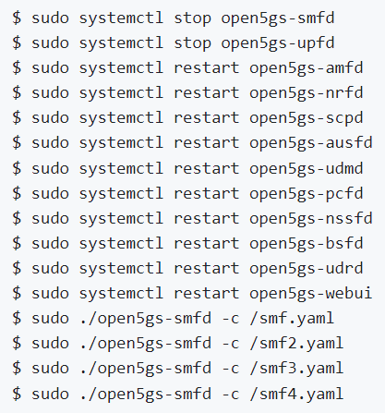
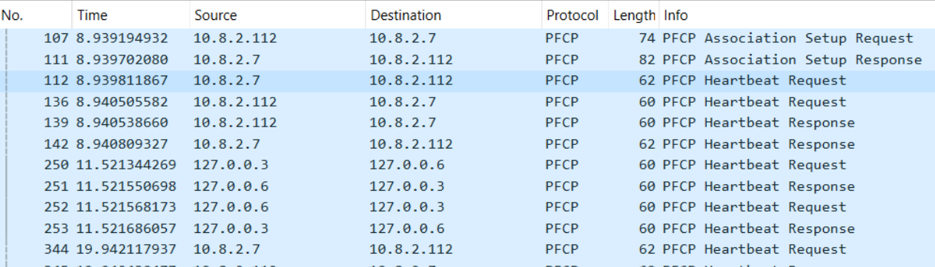
Execution
B) SMF1 to UPF1 connection Establishment
The wireshark traces of PFCP association b/w SMF1 and UPF1
Restart 5GC services
12

Slide 13
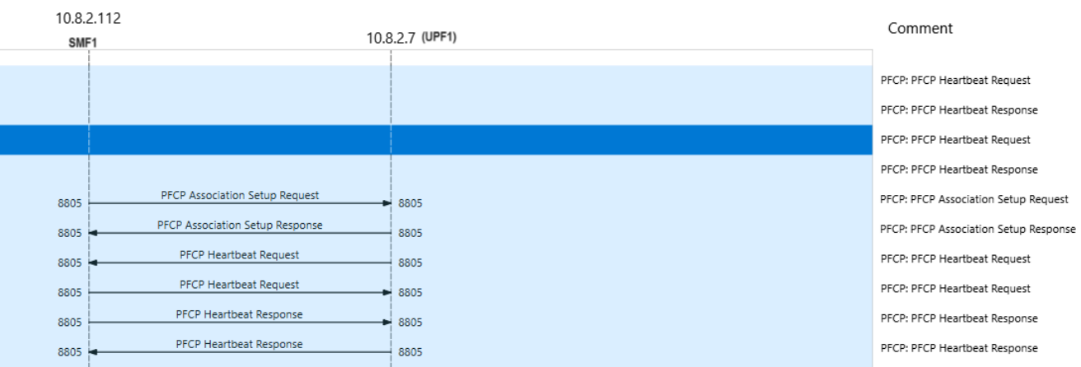
The MSC of PFCP association b/w SMF1 and UPF1
13

Slide 14
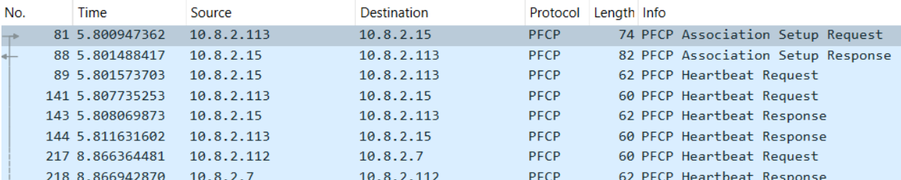
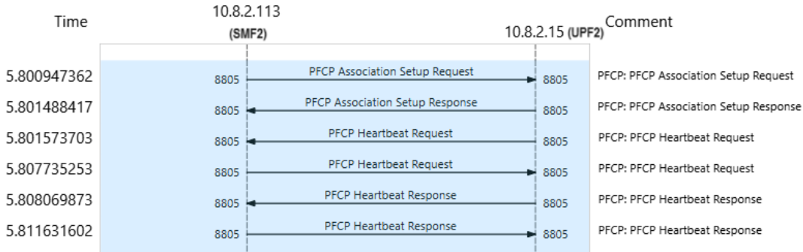
SMF2 to UPF2 connection Establishment.
wireshark traces of PFCP association between SMF2 and UPF2
The MSC of PFCP association between SMF2 and UPF2
14

Slide 15
Running UERANSIM
NG Setup between gNB 1 & 2 to AMF
To ensure successful connection between 5GC and gnb, we need to receive “NG connection successful” in the same terminal.
The successful initialization of UE can be verified by receiving “PDU Session Establishment successful”
15

Slide 16
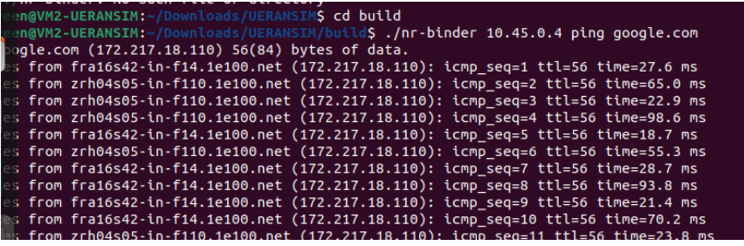
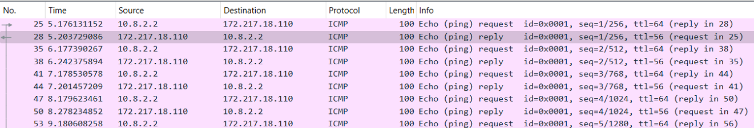
Testing & accessing Data Networks
Testing the network using UE1
To ping google.com Open a new terminal ./nr-binder 10.45.0.4 ping google.com
Wireshark traces
16

Slide 17
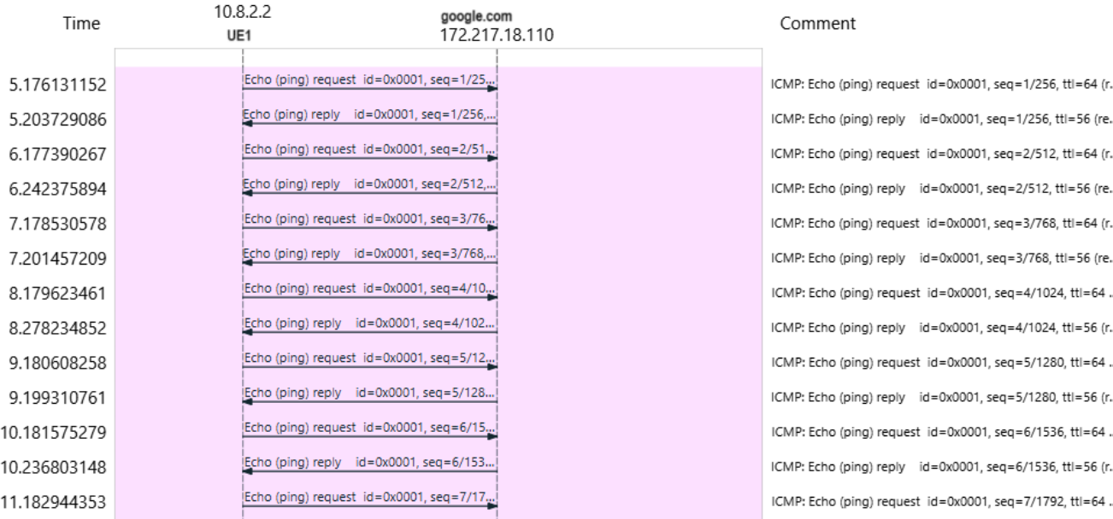
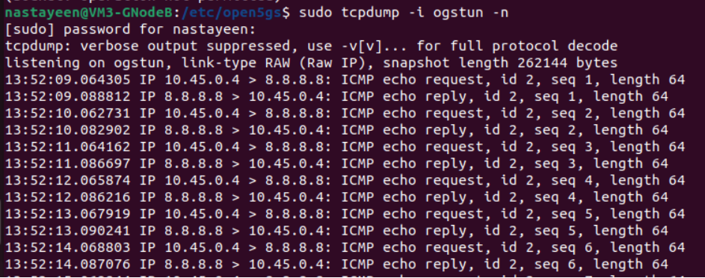
MSC diagram
Confirm by using tcpdump that the packet goes through if=ogstun on U-Plane1
17

Slide 18
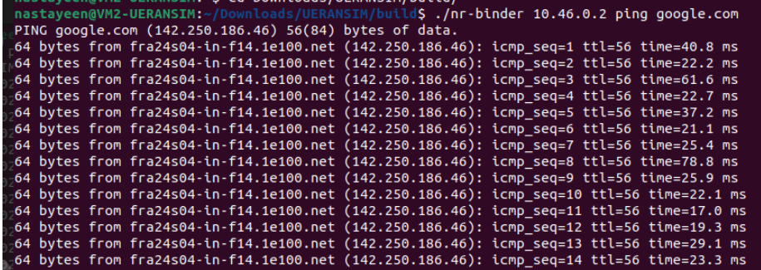
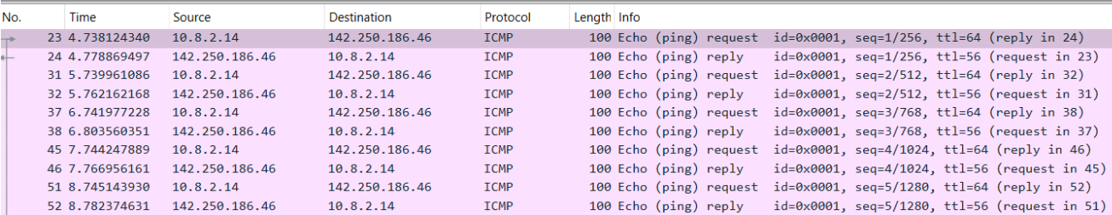
Testing the network using UE2 via
To ping google.com Open a new terminal
Wireshark traces
18

Slide 19
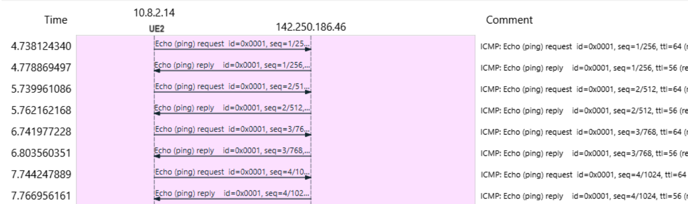
MSC diagram
19

Slide 20
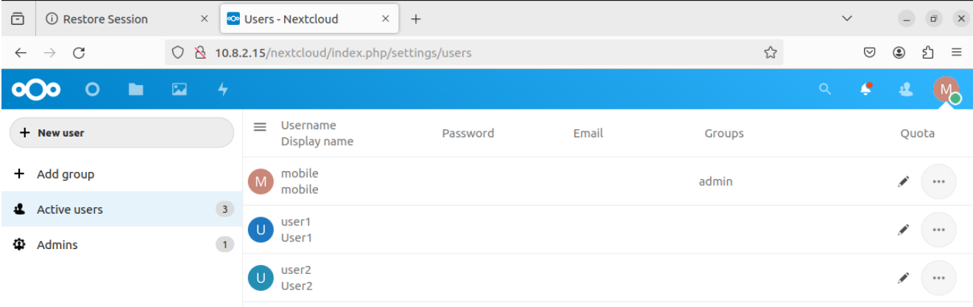
Network slicing
Next Cloud
Nextcloud is a self-hosted, open-source file sharing and collaboration platform that allows users to store, access, and share their data from any device or location.
UE1 send file to UE2
Creation on Users in Next Cloud (Server)
20

Slide 21
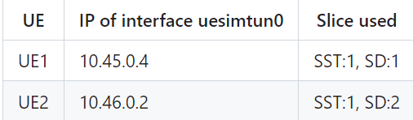
Steps to access file sharing service
NG Connection establishment between gNB and 5GC-Control Plane.
PDU session establishment between U-Plane 1 and UE1.
PDU session establishment between U-Plane 2 and UE2.
The IP address for the ‘uesimtun0’ interfaces of both the UEs:
Once the UEs are assigned the IP addresses on ‘uesimtun0’ interface, ‘nr-binder’ tool is available as a part of UERANSIM to access the NextCloud server via web browser already installed in both UE1 and UE2
21

Slide 22
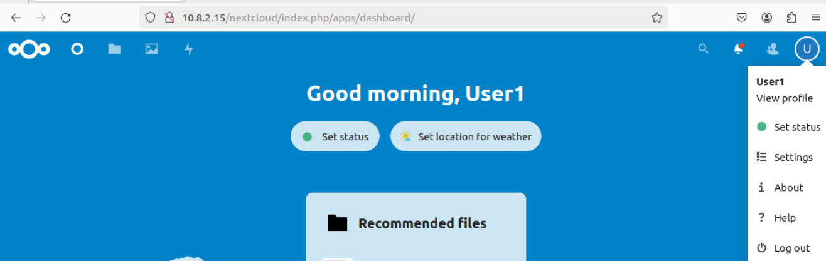
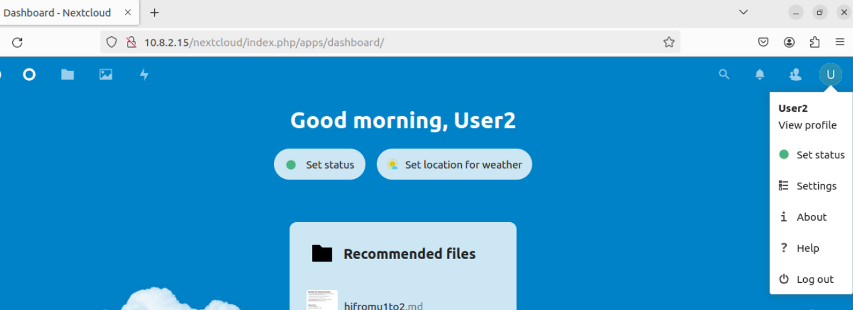
6. In the browser windows the NextCloud server can be accessed from the url https://10.8.2.15/nextcloud/ by logging in to users ‘UE1’ and ‘UE2’ already registered in the NextCloud server (10.8.2.15) ‘ue1’ and ‘ue2’ respectively.
22

Slide 23
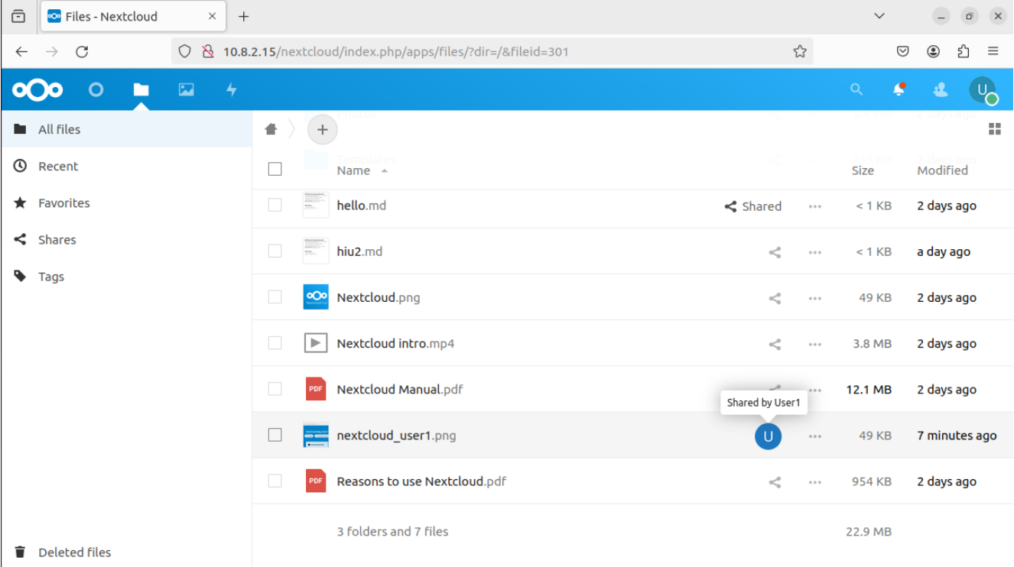
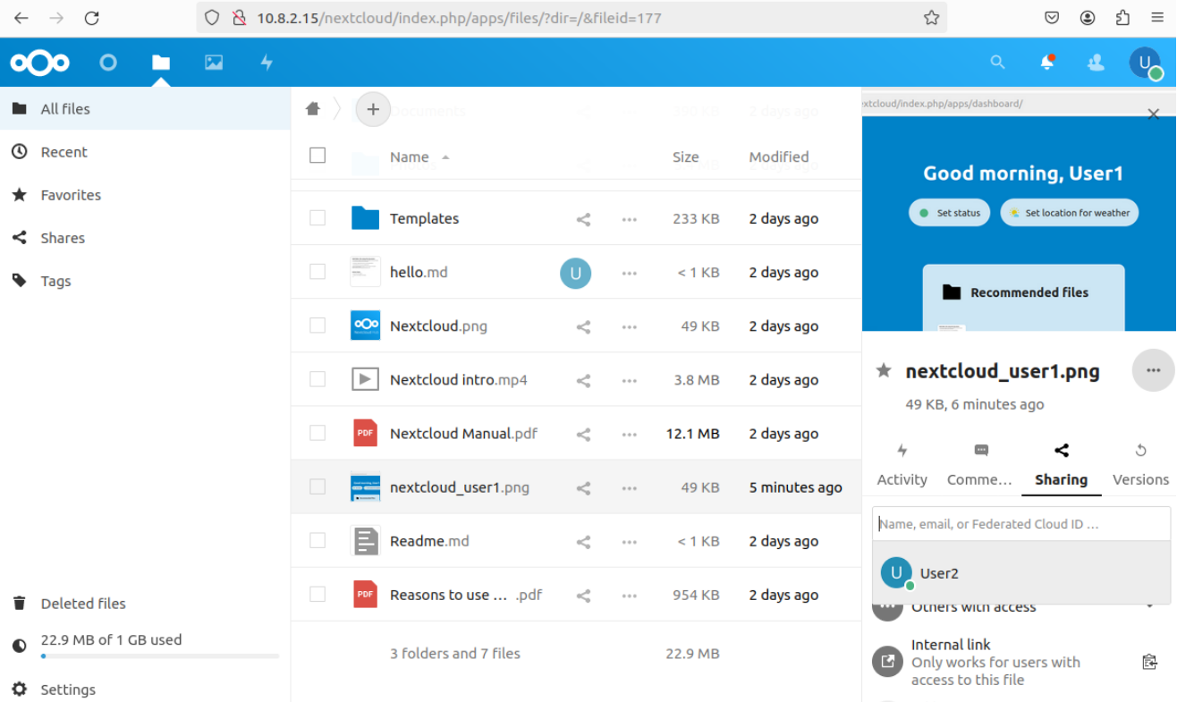
File Sharing from UE1(SST:1, SD:1) to UE2() (Server)
23

Slide 24
Conclusion
24

Slide 25
References
Ulrich Trick 5G - An Introduction to the 5th Generation Mobile Networks 5G by Prof. Dr.-Ing. Ulrich Trick, Frankfurt University of Applied Sciences, Research Group for Telecommunications Networks, Nibelungenplatz 1, 60318 Frankfurt/M., Germany
25

